Slide 1
DBSCAN
Density Based Spatial Clustering of Applications with Noise

Slide 2
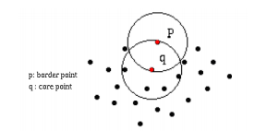
Some concepts
Have database D with n object and and we want to partition it into k clusters
Objects in each cluster are classif
core point :objects inside the cluster
border point :objects located on the border of the cluster

Slide 3

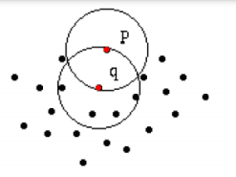
Eps-neighborhood of a point
IN IMAGE: Q is Eps-neighborhood of P

Slide 4

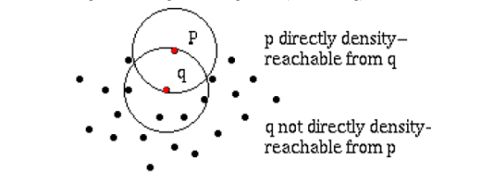
Directly density-reachable

Slide 5

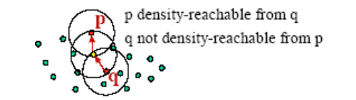
Density-reachable (selide1)

Slide 6
Density-reachable (selide2)
- density-reachable relationships are directly density-reachable extension.
- Density-reachable relationship is demanding
- If p, q are all core objects, the density-reachable relationship is symmetrical, meaning that p is reachable by density from q and vice versa.
- If p, q are border points, then p cannot reach the density from q and vice versa.
- If in p, q there is a core object (core point), a boundary object as shown above, only the boundary object can reach the density from the core object without the opposite direction (asymmetry).

Slide 7

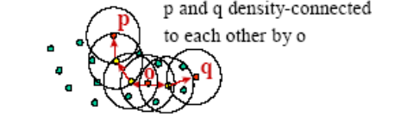
Density-connected
* For density-reachable objects with another object, the relationshipdensity-connected reflective
* A density-connected relationship with symmetry.

Slide 8
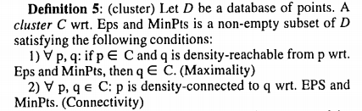
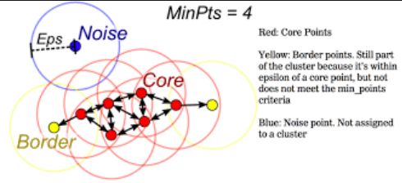
All point with yellow and red is cluster

Slide 9

Noise

Slide 10
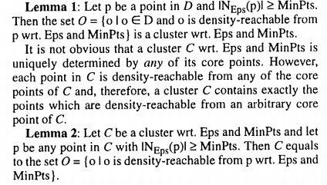

Slide 11
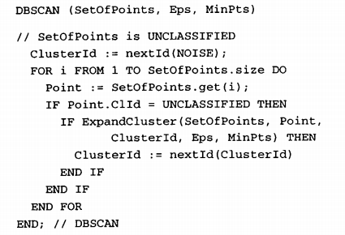
DBSCAN:The Algorithm
SetOfPoints is either the whole database or a discovered cluster from a previous run
Eps and MinPts are the global density parameters determined either manually or according to the heuristics presented

Slide 12
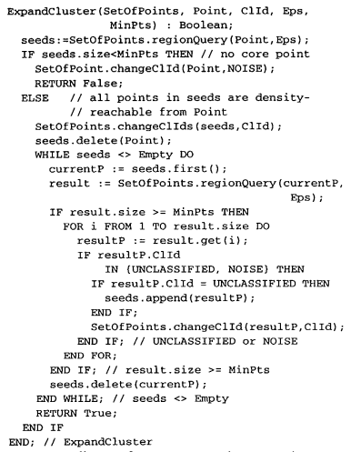
ExpandCluster Function
returns the Eps-Neighb0rho0d Point in SetOfPoints aa list of points

Slide 13
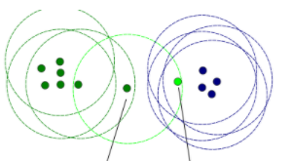
Note
If two clusters C1 and C2 are very close to each other, it might happen that some point p belongs to both, C1 and 2. C Then p must be a border point in both clusters because otherwise C1 would be equal to C2 since we use global parameter
The CLId (clusterId) of points which have been marked to be NOISE may be changed later, if they are density-reachable from some other point of the database

Slide 14

Determining the Parameters Eps and MinPts
- For a given k we define a function k-dist from the database D to the real numbers, mapping each point to the distance from its k-th nearest neighbor.
- When sorting the points of the database in descending order of their
k-dist values, the graph of this function gives some hints concerning the density distribution in the database. We call this graph the sorted k-dist graph.
- with an equal or smaller k-dist value will be core points. If
we could find a threshold point with the maximal k-dist value in the "thinnest" cluster of D we would have the desired parameter values.
- The threshold point is the first point in the first "valley" of the sorted k-dist graph (see figure 4).
- All points with a higher k-dist value ( left of the threshold) are
considered to be noise, all other points (right of the threshold) are assigned to some cluster

Slide 15
Determining the Parameters Eps and MinPts
experiments indicate that the k-dist graphs for k > 4 do not significantly differ from the 4-dist graph and, furthermore, they need considerably more computation. Therefore, we eliminate the parameter MinPts by setting it to 4 for all databases
The system computes and displays the 4-dist graph for the database.
If the user can estimate the percentage of noise, this percentage is entered and the system derives a proposal for the threshold point from it.
The user either accepts the proposed threshold or selects another point as the threshold point. The 4-dist value of the threshold point is used as the Eps value for DBSCA

Slide 16
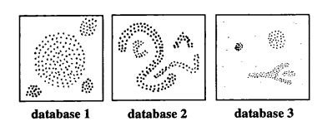
Advantages of the algorithm
Explore clusters
Only one input parameter is re
Scalability: Effective in large databasesquired (noise percentage)of any shape
Ability to handle interference

Slide 17
Disadvantages of the algorithm
In some cases, determining the appropriate proximity of the neighborhood (eps) is not easy and it requires domain knowledge.
If the clusters are very different in density within the cluster, then DBSCAN is not suitable for defining clusters

Slide 18
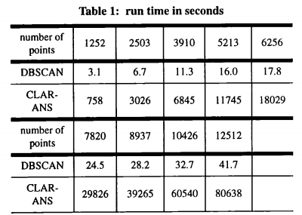
Performance Evaluation

Slide 19


